Slide 1

Additional Pattern:
Dependency Injection
00

Slide 2

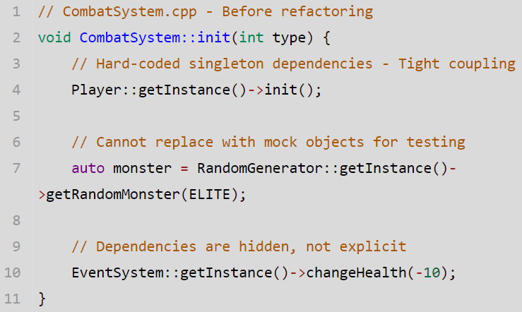
Additional Pattern: Dependency Injection
CombatSystem Refactoring
Before
Overview
Instead of a class creating its own dependencies, the dependencies are "injected" from outside by a caller or container.
Issue Before Refactoring
1.Tight Coupling: Classes directly depend on concrete implementations
2.Unit Test Difficulty: Tests rely on concrete implementations that involves randon behavior
3.Hidden Dependencies: Cannot know what dependencies are needed by just by looking at the class declaration

Slide 3
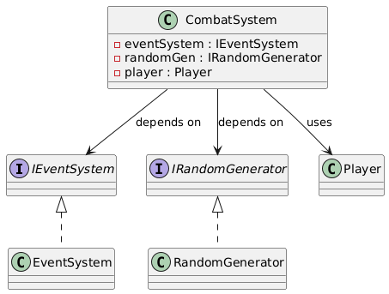
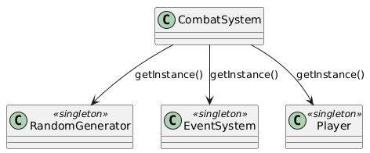
Additional Pattern: Dependency Injection
UML Changes
After
Before
Refactor Overview
1.Interface-Based Design: Created `IRandomGenerator` and `IEventSystem` interfaces instead of concretions
2.Constructor Injection: Dependencies are passed through constructor, which is explicit and type-safe

Slide 4
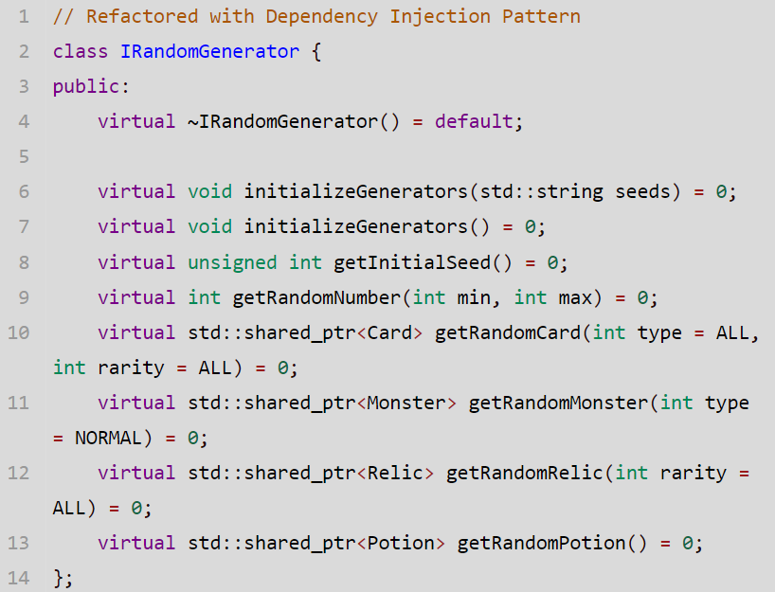
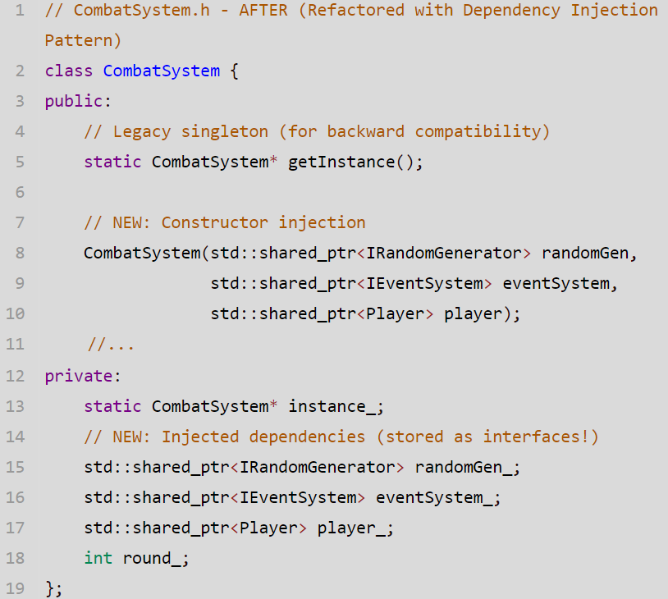
Additional Pattern: Dependency Injection
Detailed implementation
1. IRandomGenerator Interface
2. CombatSystem Refactoring

Slide 5
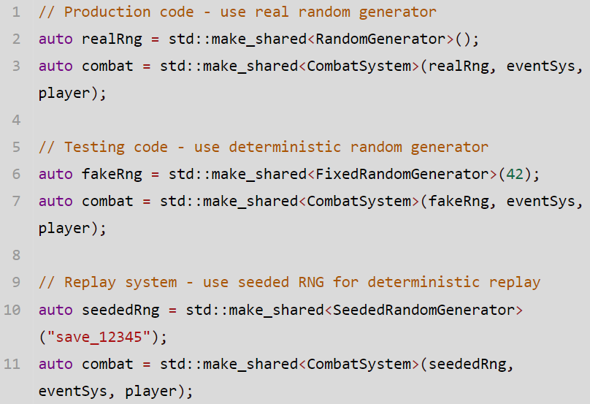
Additional Pattern: Dependency Injection
Advantages
Switching generators
1 Testability with Mock Objects
After refactoring, we can now easily inject mock objects for testing.
2 Explicit Dependencies
Just by reading the constructor signature, we immediately know that `CombatSystem` requires a random generator, event system, and player object.
3 Easy Testing
By using interface instead of concrete inplementations,we can easily switch generators and use determined generators for testing

